Slide 1




COURIER MANAGEMENT SYSTEM.
Team Members(Group -07):
Falak Khan - 2BU19CS010
Ashwini Toranagatti - 2BU19CS009
Course Coordinator:
Prof. Sushiladevi B Vantamuri

Slide 2
CONTENTS:
ABSTRACT
INTRODUCTION
SYSTEM REQUIREMENTS
BRIEF OVERVIEW OF THE TECHNOLOGY
METHODOLOGY
EXISTING SYSTEM
PROPOSED SYSTEM
SCREENSHOTS
RESULT AND CONCLUSION
REFERENCES

Slide 3

ABSTRACT:
The purpose of Courier Management System is to automate the existing manual system by the help of computerized equipment and full-fledged computer software, fulfilling their requirements, so that their valuable data/information can be stored for a longer period with easy accessing and manipulation of the same.
The organization can maintain computerized records without redundant entries. That means that one need not be distracted by information that is not relevant, while being able to reach the information.
Basically the project describes how to manage the data for good performance and better services for the clients.

Slide 4
INTRODUCTION:
Courier Management System (CMS) is a modular full business software framework for an enterprise which posses operations in domestic and courier services.
The application is reduced as much as possible to avoid errors while entering the data. CMS solution handles the end to end process staring from initiating a courier order, driver pickup and delivery of a courier business.
The main concern of the courier agency is to deliver the right parcel to its owner. To accomplish it the agency has to maintain the record of the customer details like personal, courier.

Slide 5
SYSTEM REQUIREMENTS:
Hardware Requirements:
Ram 128MB or above
Harddisk 150MB or above
Software Requirements:
Apache server 2.0
Processor i3 or above , ryzen
PHP version 5.3 or above
MySQL version 5.0 or above
Latest browser(chrome, firefox etc)
Operating system(windows, mac, linux)

Slide 6
BRIEF OVERVIEW OF TECHNOLOGY:
Front end:
HTML, CSS, Bootstrap
HTML: HTML is used to create and save web document. E.g. Notepad/Notepad++
CSS : (Cascading Style Sheets) Creates attractive Layout and used for styling of the website
Bootstrap : responsive design of website.
BACKEND:
PHP, MySQL
PHP: Hypertext Pre-processor (PHP) is a technology that allows software developers to create dynamically generated web pages, in HTML, XML, or other document types, as per client request. PHP is open source software.
MySQL: MySQL is a database, widely used for accessing querying, updating, and managing data in databases.

Slide 7
METHODOLOGY:
Courier management computerization is “the incorporate of appropriate technology to help administrator manage information.
Technology is considered appropriate, when it utilizes the most abundant domestic resources and conserves capital and skilled personnel”.
The main purpose of this system is to connect all branches to center databases
so that everywhere information is same. This system increases efficiency and also
increases customer satisfication level.
The main aim of this project is to computerize the maintenance of courier management.

Slide 8
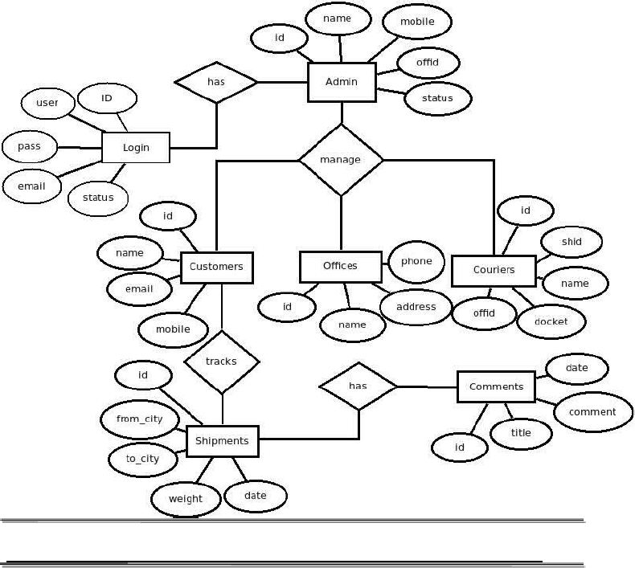
ENTITY-RELATIONSHIP DIAGRAM:

Slide 9
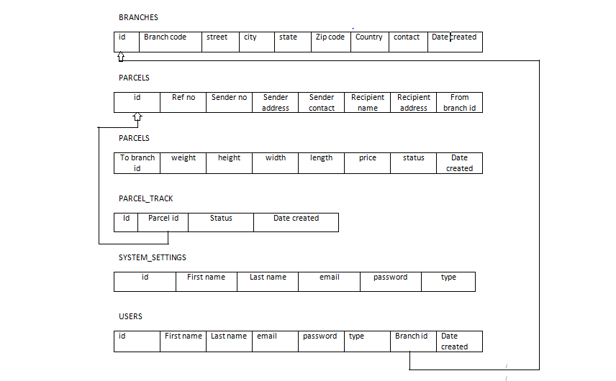
SCHEMA DIAGRAM:

Slide 10
ENTITIES AND ATTRIBUTES:
ENTITY: BRANCHES | ATTRIBUTES:
 | ID
 | BRANCH_CODE
 | STREET
 | CITY
 | STATE
 | ZIP CODE
 | COUNTRY
 | CONTACT
 | DATE

Slide 11
ENTITY: PARCELS | ATTRIBUTES:
 | ID
 | REFERENCE_NO
 | SENDER_NAME
 | SENDER_ADDRESS
 | RECIPIENT_NAME
 | RECEIPIENT_ADDRESS
 | FROMBRANCH_ID
 | TOBRANCH_ID
 | WEIGHT
 | HEIGHT
 | PRICE
 | STATUS

Slide 12
ENTITY: USERS | ATTRIBUTES:
 | ID
 | FIRST_NAME
 | LAST_NAME
 | EMAIL
 | PASSWORD
 | BRANCH_ID
 | DATE

Slide 13
ENTITY: PARCEL_TRACKS | ATTRIBUTES:
 | REFERENCE_NUMBER
 | PARCEL_ID
 | STATUS
 | DATE
ENTITY: SYSTEM_SETTINGS | ATTRIBUTES:
 | ID
 | NAME
 | EMAIL
 | CONTACT_NUM
 | ADDRESS

Slide 14
EXISTING SYSTEM:
The existing system is not totally automated. Though the system is computerized to a particular extent, it has to do a lot of manual work.
The different processes involved are:
To maintain details of bookings manually.
Calculate salaries of the employees.
To maintain details of the incoming couriers.
To maintain returns details.
To maintain out return details.

Slide 15

PROPOSED SYSTEM:
In the proposed Courier Management System, all the work is automated, If someone needs to send any courier than he or she can just login into the panel and send a request to the courier company and then the courier team can themselves contact you.
In proposed Courier Management System, we need not to waste our time in any procedure and or in following any step, and all the work is done so easily without taking much time.

Slide 16
WORKING:
The system has a tracking feature where can help to monitor the movement of the customer’s parcel. The system has two types of user which is the Admin user and the Branch Staff user.
The Admin user can manage all the data in the system, including managing the branches and branches staff user. The Branch user can only track a parcel and manage the list of packages where the origin or the destination of a parcel under the logged-in staff branch.
The couriered items have multiple statuses, which are the “Item Accepted by Courier”, “Collected”, “Shipped”, “In-Transit”, “Arrived At Destination”, “Out for Delivery”, “Ready to Pickup”, “Delivered”, “Picked-up”, and “Unsuccessful Delivery Attempt”.

Slide 17
ADVANTAGES:
TIME REDUCTION
TRACKS DRIVE PERFORMANCE
EFFECTIVE MANAGEMENT OF DATA
SMART TRACKING FEATURE
USER SATISFACTION
DEMATERIALIZATION OF DATA
EASY ACCESS OF DATA
RESPONSIVE DESIGN.

Slide 18
SCREENSHOTS:

Slide 19
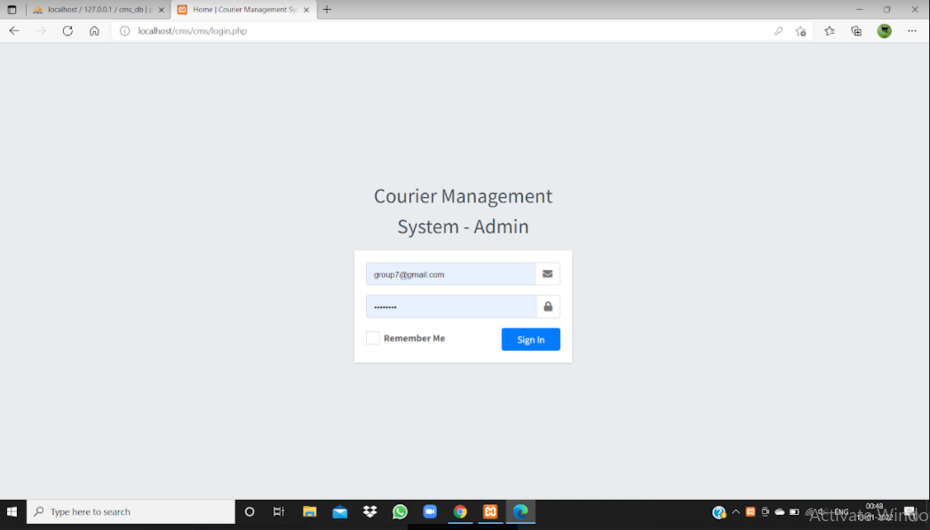
Figure 1:This page displays Admin Login Page

Slide 20
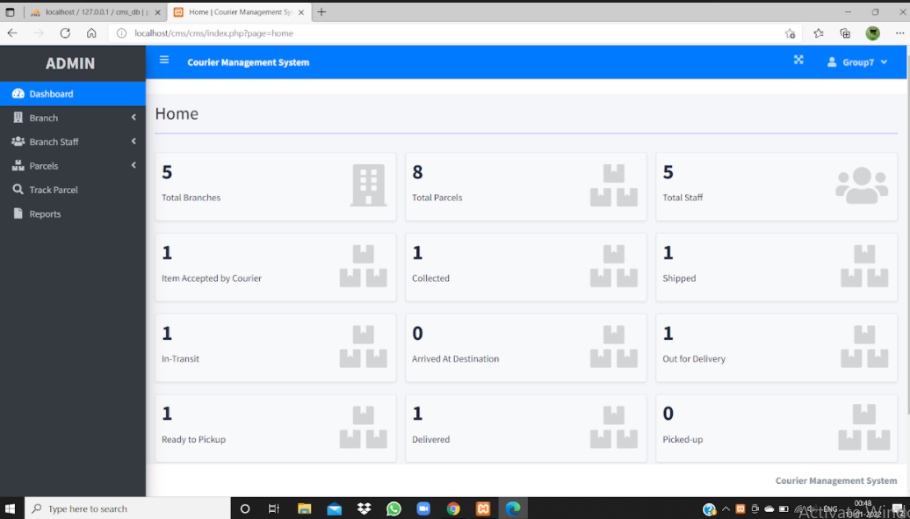
Figure 2: Displays Dashboard Page

Slide 21
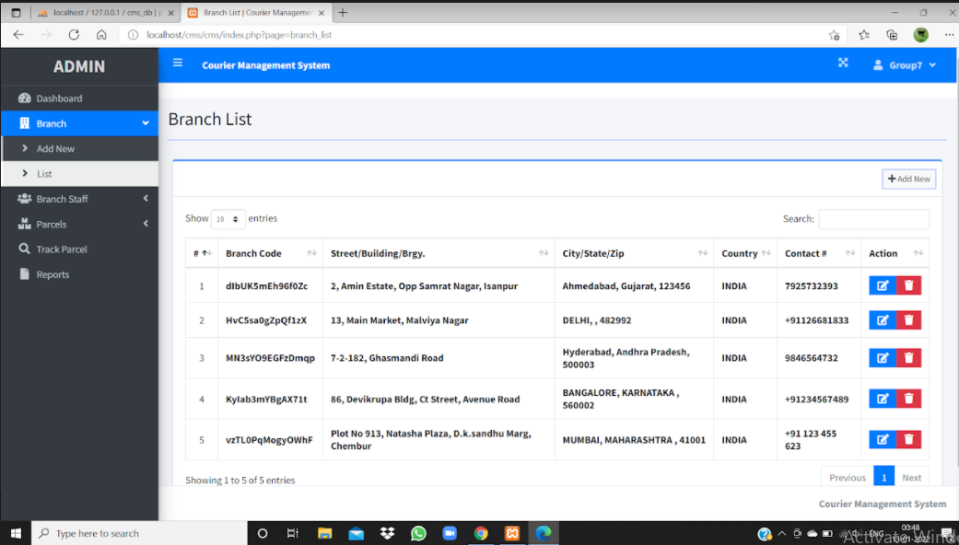
Figure 3: Displays the Branch List Page

Slide 22
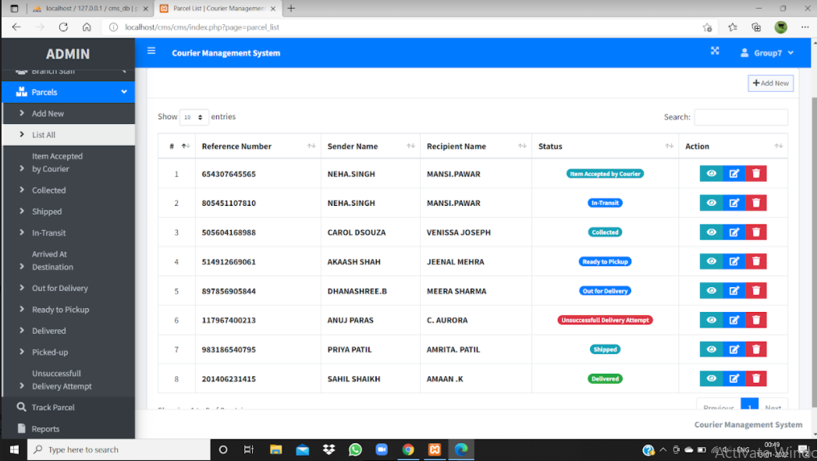
Figure 4: Displays the Parcel List Page

Slide 23
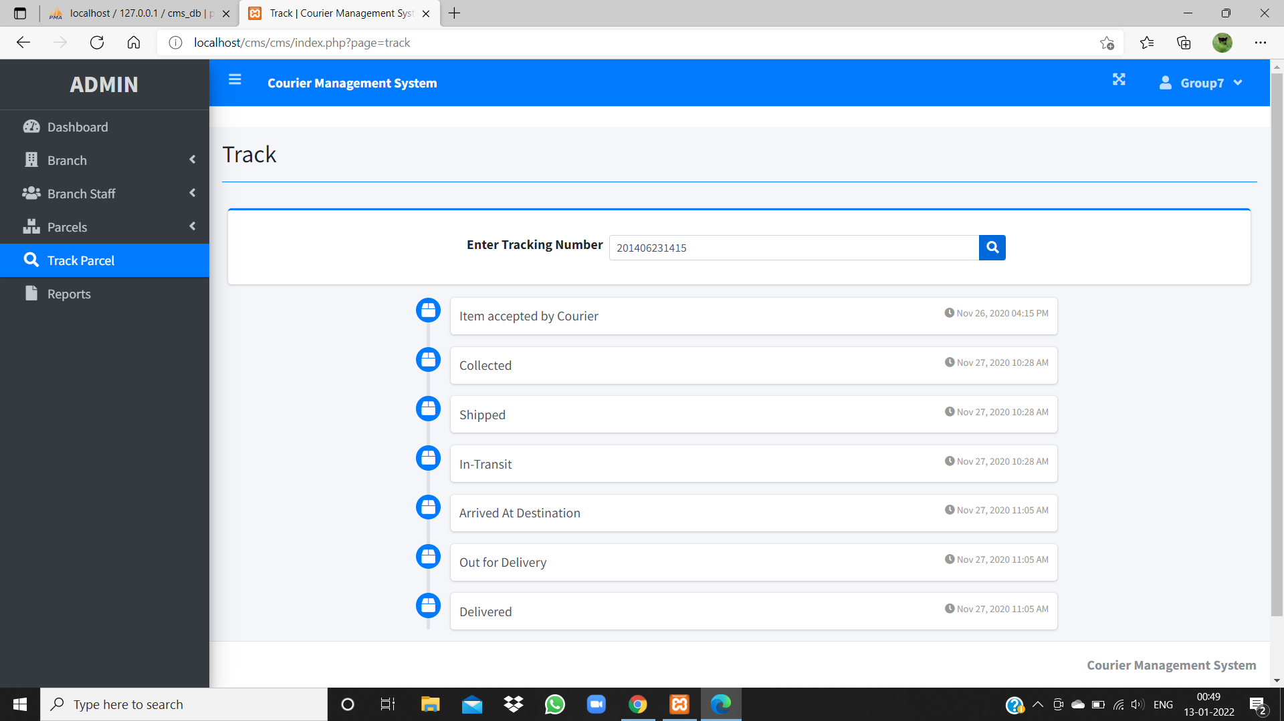
Figure 5: Displays the Track Parcel Page

Slide 24
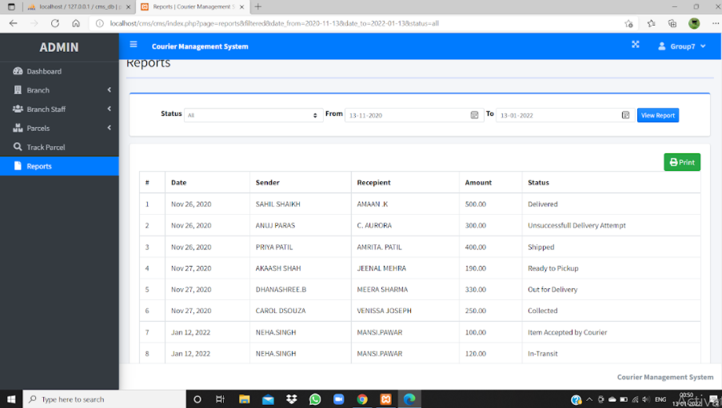
Figure 6: Displays the Report Page

Slide 25
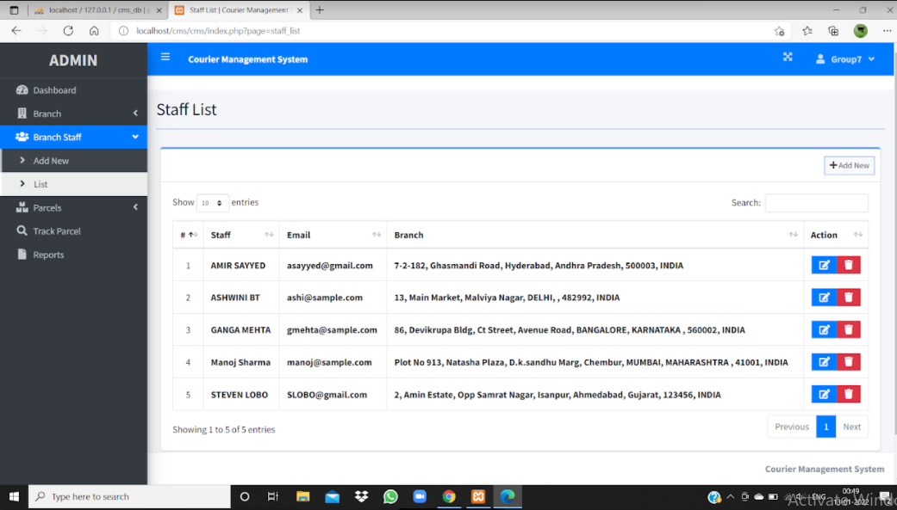
Figure 8: Displays the Branch Staff List Page

Slide 26
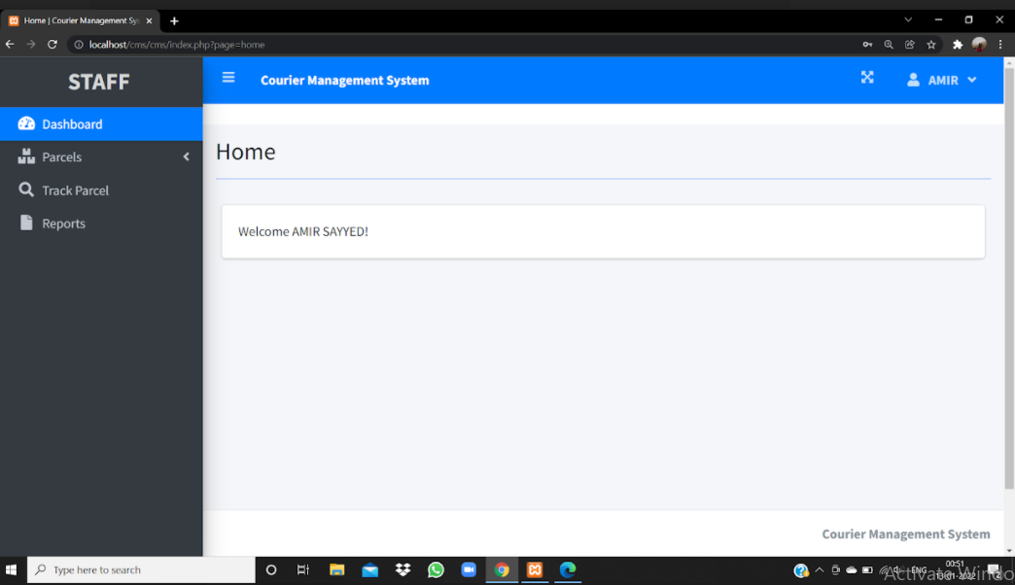
Figure 7: Displays the staff dashboard

Slide 27
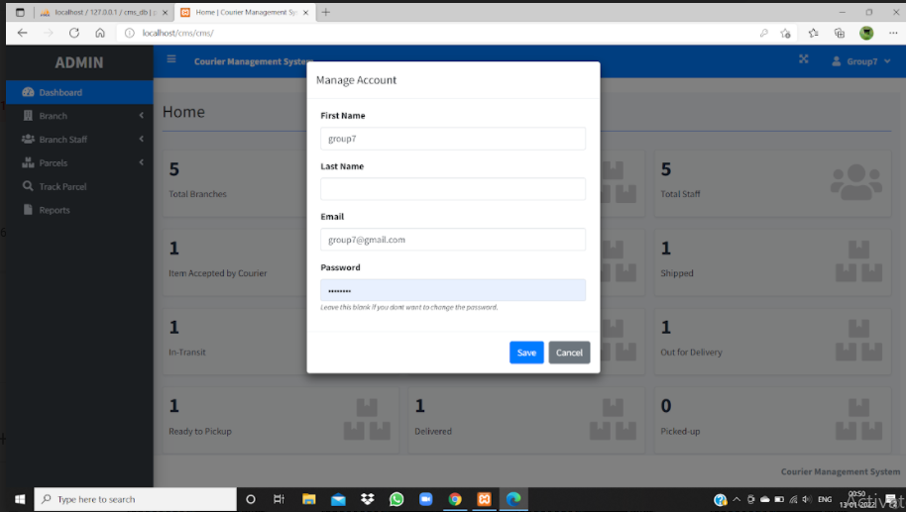
Figure 9:Displays the Manage Account Page

Slide 28
RESULT AND CONCLUSION:
To summarize, the world is rapidly evolving and heading toward technical expertise. Technology is not a static or stagnant field, but rather one that is constantly changing as new trends arise. As patterns change and improve, it's past time for us to change with them.
The use of courier management systems is important for getting accountability and making goods get delivered quickly and making the work easier. As a result, this system would make it easier to manage and maintain the data.

Slide 29
REFERENCES:
(Yusuf Malik, 2018)- How to perform System Testing using various types of techniques? Retrieved from https://www.loginworks.com/blogs/how-to-perform-system-testing-using-various-types-of-techniques/
(Software Testing Help, 2018) - Types of Software Testing: Different Testing Types with Details. Retrieved from (https://www.softwaretestinghelp.com/types-of-software-testing/)
(Lorri Mealey, 2018) - Different Types of Restaurant Concepts. Retrieved from https://www.thebalancesmb.com/different-types-of-restaurant-concepts-2888698.

Slide 30
THANK YOU

